Slide 1


01 // THE PROBLEM
The Semantic Gap in Regulatory Compliance.
Indian MSMEs struggle to map colloquial product descriptions to strict alphanumeric BIS standards. This gap turns simple queries into weeks-long manual consulting, draining capital and delaying market entry.
Unstructured Data
High Ambiguity
Hallucination Risks
Regulatory texts like BIS issues are dense and tabular.
Not searchable by natural intent
Highly complex structures
Manual parsing required
Standard keyword searches fail to distinguish nuances.
Confuses material types
Misinterprets use-cases
Lacks contextual logic
Off-the-shelf LLMs are dangerous for compliance.
Invents fake "IS" codes
Confident misinformation
Zero factual grounding

Slide 2


02 // The Solution
Solution Overview
A Production-Ready Discovery Pipeline.
An interactive dashboard powered by a deterministic, offline-capable RAG engine that maps natural-language queries to approved IS codes.
// JSON Output Specification
{
"retrieved": [
"IS 455: 1989",
"IS 269: 1989",
"IS 1489 (Part 1): 1991"
],
"rationale": "IS 455 is the standard for Portland slag cement, covering its manufacture and physical requirements.",
"latency_seconds": 1.6
}
Mode 1: AI Agent Search
Direct natural-language processing with real-time AI rationale generation via localized Ollama models.
Mode 2: Guided Discovery
Click-through structured workflow (Category - Keyword - Standard) for rapid browsing without typing.
Key Pipeline Advantages
Zero-Latency Local Inference: Ensures data privacy and offline operational capability.
Deterministic Cross-Referencing: Eliminates AI hallucinations by grounding results in official IS standards.
Context-Aware Mapping: Bridges the semantic gap between MSME colloquialisms and technical regulatory language.

Slide 3
03 // ARCHITECTURE
System Architecture
User Query / API Input (FastAPI)
↓
Dense Retrieval FAISS BGE-M3 (Top-25)
Sparse Retrieval BM25 (Top-25)
↓
RRF Fusion & Feature Scoring Pipeline
↓
Family Resolution & Confidence Check (Margin > 10)
↓
LLM Rationale Generation Local Ollama (Gemma4:e2b)
Core Stack
FastAPI & FAISS-CPU: High-performance serving and vector indexing
BGE-M3 & Gemma4:e2b: State-of-the-art embedding and consumer local reasoning models
PyPDF: Reliable regulatory document parsing
Execution Environment
Reproducible Deployment: Fully containerized offline-ready setup
Hardware Agnostic: Dynamic CUDA/CPU fallback mechanisms
Compliance Validated: Strict inference.py evaluation standard compliance

Slide 4
04 // SECRET SAUCE
Chunking & Deterministic Scoring
Standard vector databases fail on strict alphanumeric codes. We engineered a custom Feature Scoring algorithm that ranks RRF Fusion candidates deterministically.
Algorithm Weights
Query Signal Extraction
IS Number Exact Match +36 pts
Part Alignment Match (correct) +18 pts
Product Type Classification +11 pts
Title keyword overlap +9 pts
Bigram overlap +6 pts
Material overlap +5 pts
Keyword overlap +4 pts
Content keyword overlap +1 pts
Mutual Exclusivity Mismatch -24 pts
Near-ID Penalty (736 vs 737) -16 pts
Part Alignment (wrong part) -12 pts
Part Alignment (missing) -2 pts
The system parses exact signals (bigrams, material types, "part" mentions) before vectorization to guide the sparse retriever.
Confidence Fallback
If the top score margin is < 10, the engine widens the candidate pool to 30, preventing confident hallucination of incorrect standards.

Slide 5
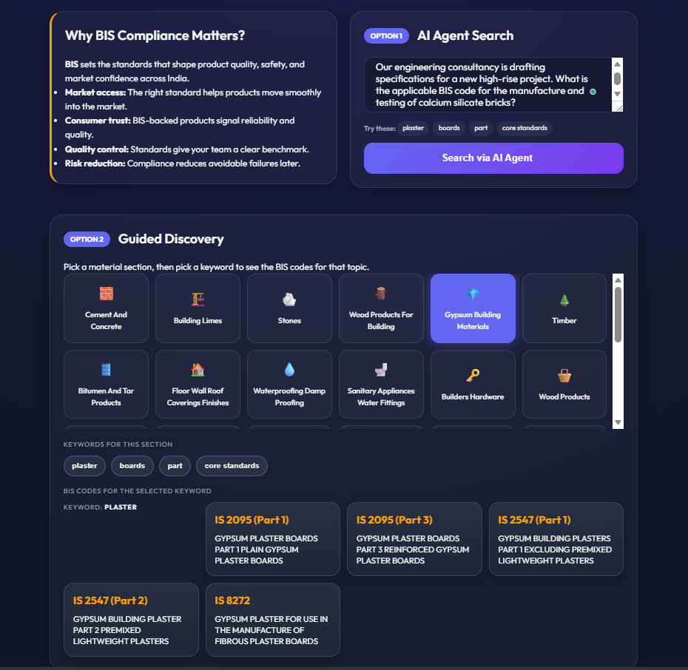
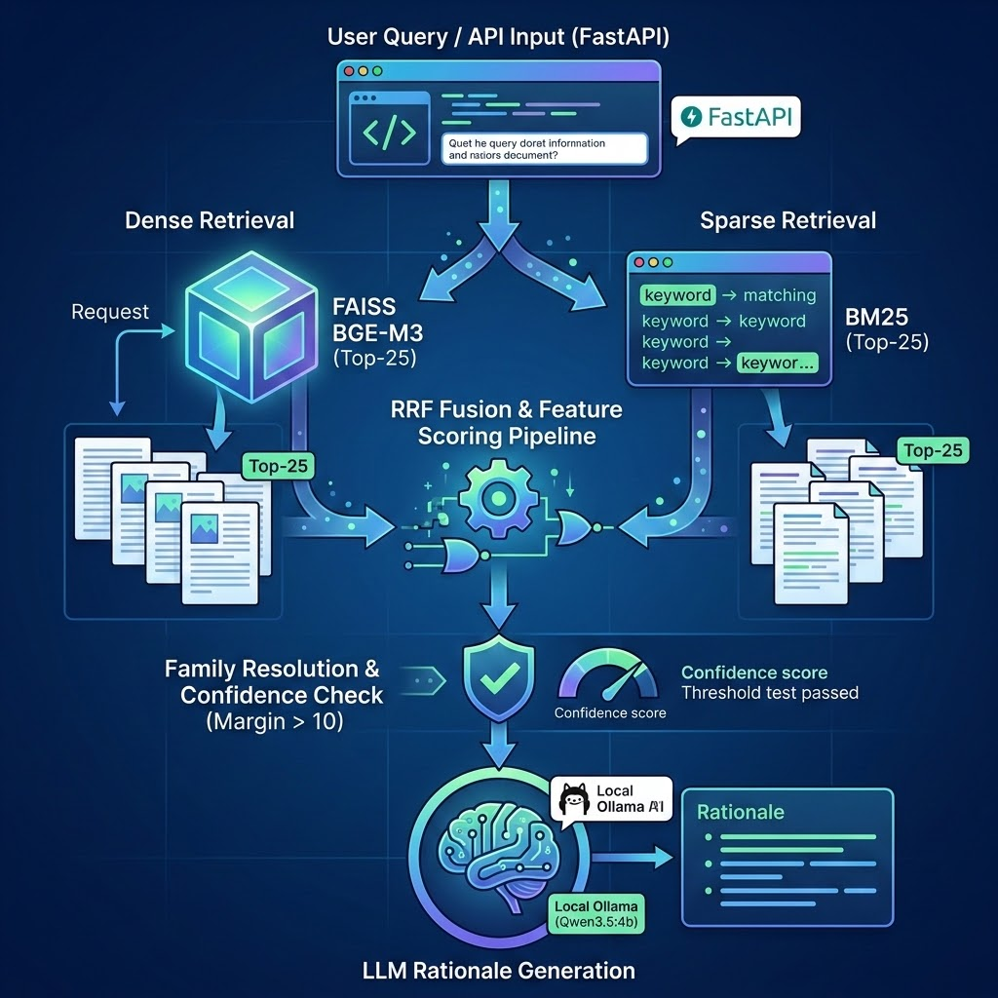
05 // DEMO
Live Application Interface
App.py Interface
Inside the system
Visual comparison of AI Search vs. Guided Discovery modes.
Detailed breakdown what happens inside the system when user interacts on AI AGENT QUERY on the web interface

Slide 6
06 // EVALUATION
Crushing the Benchmarks
Results generated deterministically against the mandatory eval_script.py suite.
Hit Rate @3
MRR @5
Avg. Latency
90%
0.920
~1.1s
Correct standard found in top 3
Mean Reciprocal Rank precision
End-to-end processing time (On Desktop Nvidia RTX4060Ti)
Target: >80%
Target: >0.70
Target: <5.0s
*The above results were scored on public test set. However, it scores even higher with scores of Hit Rate@3=98%,MRR@5=0.9390 on custom 100 query datasets which is mentioned in the Github repo.

Slide 7
07 // BUSINESS VALUE
Real-World Impact on MSMEs
Time-to-Market
Zero-Cost Intelligence
Data Privacy
Reduces compliance discovery from weeks to exactly 1.1 seconds.
Eliminating regulatory bottlenecks for rapid new product launches
Bypasses the need for expensive third-party compliance consultants.
Keeps vital capital inside the small enterprise where it belongs.
Runs locally on consumer grade hardware 2B parameter model, so efficient, fast and accessible.
Offline-first architecture utilizing LM Studio (Local FAISS + Local Gemma4:e2b).
Ensures proprietary MSE product details never leave their servers.
All components bearing Apache2.0 License.

Slide 8

08 // Conclusion
Project Details
Aditya K
AI / Backend Developer
REPOSITORY
github.com/AdityaProCoder/bis_rag
Special thanks to the hackathon organizers for providing the BIS dataset and a rigorous evaluation framework.
Built entirely within the hackathon timeframe.

